Slide 1
Finding Hope in God’s Comfort
Isaiah 40

Slide 2
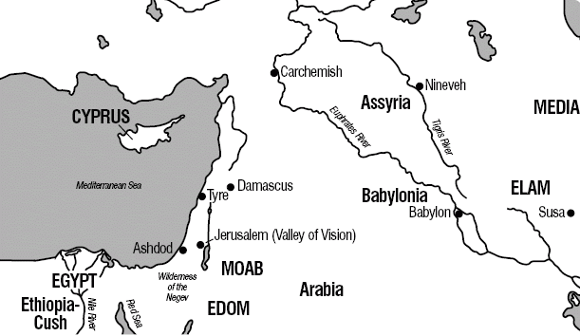

Slide 3
